Slide 1

Hands-on XAI
24.06.2022
Mahmoud Draz and Sophia Elsholz

Slide 2
GO TO: Slido.com
# 4109091

Slide 3

Workshop Repo
https://github.com/mahmouddraz/xai

Slide 4
Plan for today
1
Introduction to XAI
2
Introducing and implementing different XAI-methods
Permutation Importance
Class Activation Maps (CAM)
Saliency Maps
Gradient weighted-CAM (Homework)
LIME
SHAP
Global Surrogate (Homework)
Information Bottleneck Theory
3
Feedback and Outlook

Slide 5
1
Introduction to Explainable Artificial Intelligence

Slide 6
1. Introduction to XAI
"XAI will create a suite of machine learning techniques that enables human users to understand, appropriately trust, and effectively manage the emerging generation of artificially intelligent partners“ [1]
XAI
Deep Learning
Machine Learning
Artificial Intelligence

Slide 7
1. Introduction to XAI
Why do we need XAI?
Model Verification
Model Improvement
Learning from the explanation
Compliance with the law
Is the model using the right feature to make its decisions?
How to improve its generalization and fairness?
Can we use the model to improve in real life behaviour?
Is the model complaint with our societal values?
Are these decisions fair e.g. not biased?

Slide 8
1. Introduction to XAI
Taxonomy
Scope of the explanation
Global Explanations
Local Explanations
Universality of the system
Model Specific
Model Agnostic
Insight into the model
Interpretable model
Post-hoc Explainability
Methods try to explain the system as a whole.
Methods are compatible with every model.
Model is a whitebox
Methods can only explain the decision of one instance at once.
Methods can only deal with specific models and might be adjusted.
Model is a blackbox

Slide 9
1. Introduction to XAI
Taxonomy
Scope of the explanation
Global Explanations
Local Explanations
Universality
Model Specific
Model Agnostic
Insight into the model
Interpretable model
Post-hoc Explainability
Methods try to explain the system as a whole.
Methods can only deal with specific models and might be adjusted.
Model is a whitebox
Methods can only explain the decision of one instance at once.
Methods are compatible with several kind of models.
Model is a blackbox

Slide 10
1. Introduction to XAI
Taxonomy
Scope of the explanation
Global Explanations
Local Explanations
Universality
Model Specific
Model Agnostic
Approach
Algorithmic
Post-hoc
Think about designing a car, you have a closed form solution that provides the optimal model.
Methods try to explain the system as a whole.
Methods can only deal with specific models and might be adjusted.
Methods can only explain the decision of one instance at once.
Deals with the model after training and takes the model as blackbox.
Methods are compatible with several kind of models.

Slide 11


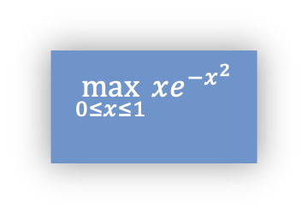
1. General Idea of different approaches
Post-hoc
Algorithmic
Process
Model
Explainer
$$\max_{0≤x≤1}{xe^{−x^{2}}}$$
Contraints
Model
Datasets
Sample
Variables

Slide 12
2
XAI Methods

Slide 13



Datasets
Dataset 1 - Stroke
Dataset 2 – Cats vs Dogs
5,110 datapoints
Tabular data
25,002 datapoints
Image data
https://www.kaggle.com/datasets/fedesoriano/
stroke-prediction-dataset
https://www.tensorflow.org/datasets/catalog/cats_vs_dogs

Slide 14

Models
AI Method 1 – Random Forest
AI Method 2 – Neural network
System of neurons and connections that is inspired by the human brain
Several decision trees that are combined [3]

Slide 15
2.1 Permutation Importance
Global Explanations
Model Agnostic
Post-hoc Explainability
Main idea
Shuffle the value of one feature column
Then check the performance of a pretrained network on this permuted dataset
The importance of a feature can then be determined by the performance change of the network
Further information can be found on https://arxiv.org/pdf/1801.01489.pdf
Id | Feature 1 | Feature 2 | Feature 3 | Feature 4
1
2
3
…
Idea: Shuffle one column and compare the performances

Slide 16
2.1 Permutation Importance
Global Explanations
Model Agnostic
Post-hoc Explainability
Algorithm
Take a model that was fit to the training set
Estimate the predicted performance of the model on a validation dataset and take that as the baseline performance
For each feature j:
Shuffle all the values of the column in the original dataset (the other columns and labels are fixed)
Record the performance on the shuffled dataset of the original network
Compute the feature importance as the absolute difference between the baseline performance and the performance of the shuffled dataset.
Repeat a - c for many times and average over all trials.

Slide 17

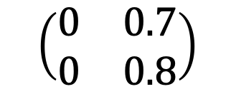
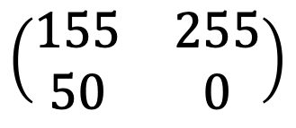
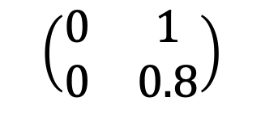
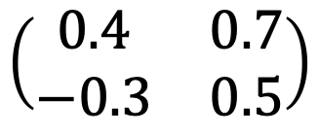
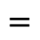
2.2 Activation Maps
Concept
Layer to recod the weights
Class Activation Map(CAM)
$$\left(\begin{matrix}155 & 255 \\ 50 & 0\end{matrix}\right)$$
Cat or dog
Gradients of the loss as weights
Saliency Map
$$\left(\begin{matrix}0.4 & 0.7 \\ −0.3 & 0.5\end{matrix}\right)$$
$$\left(\begin{matrix}0 & 1 \\ 0 & 0.8\end{matrix}\right)$$
$$\left(\begin{matrix}0 & 0.7 \\ 0 & 0.8\end{matrix}\right)$$
Combine both
$$=$$
Representations
Weights
Activation Map
Grad-CAM

Slide 18
2.2 Class Activation Map (CAM)
Local Explanations
Model Specific
Post-hoc Explainability
Input
CONV2D
MAXPOOLING
CONV2D
MAXPOOLING
CONV2D
GAP
DENSE
INPUT
CONV2D
DENSE
CONV repre-senta-tion
GAP Weights
y’
CAM-Model

Slide 19
2.5 LIME Local Interpretable Model-Agnostic Explanations
Local Explanations
Model Agnostic
Post-hoc Explainability
Point of class 1
Point of class 2
Step 1 We have a model with a nonlinear
decision function
Step 2 We decide on one data point that we want to inspect further

Slide 20
2.5 LIME Local Interpretable Model-Agnostic Explanations
Local Explanations
Model Agnostic
Post-hoc Explainability
Point of class 1
Point of class 2
Step 3 Sampling around this datapoint. For every new datapoint we can compute the distance with a similarity kernel.
Step 4 With the new points we can do regression to find a local fitting decision function.

Slide 21

2.5 LIME
Local Explanations
Model Agnostic
Post-hoc Explainability
Stroke
No Stroke
0 years
Age
100 years
0 years
Age
100 years
150 kg
150 kg
Weight
Weight
0 kg
0 kg
Step 3 Sampling around this datapoint. For every new datapoint we can compute the distance with a similarity kernel.
Step 4 With the new points we can do regression to find a local fitting decision function.

Slide 22


2.5 LIME
Local Explanations
Model Agnostic
Post-hoc Explainability
Stroke
No Stroke
0 years
Age
100 years
150 kg
Weight
0 kg
Step 4 With the new points we can do regression to find a local fitting decision function.

Slide 23
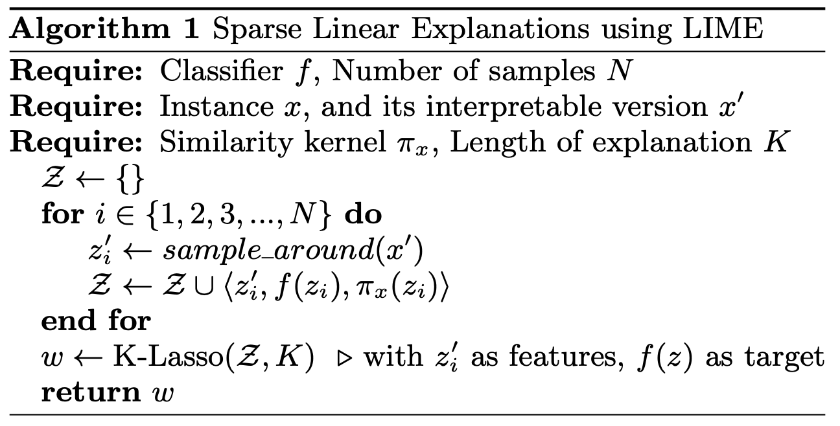
2.5 LIME Local Interpretable Model-Agnostic Explanations
Local Explanations
Model Agnostic
Post-hoc Explainability
For every sample i, draw samples in the neighborhood
Add the sample, the predicted label and similarity to Z
K-lasso is a regression method
Further information can be found on https://arxiv.org/pdf/1602.04938.pdf

Slide 24
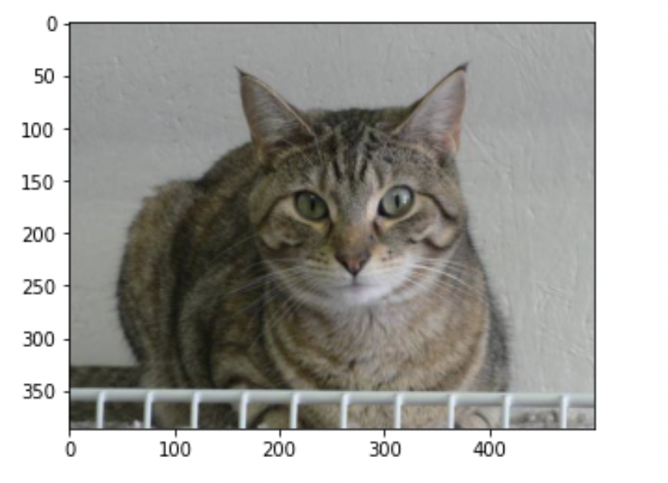
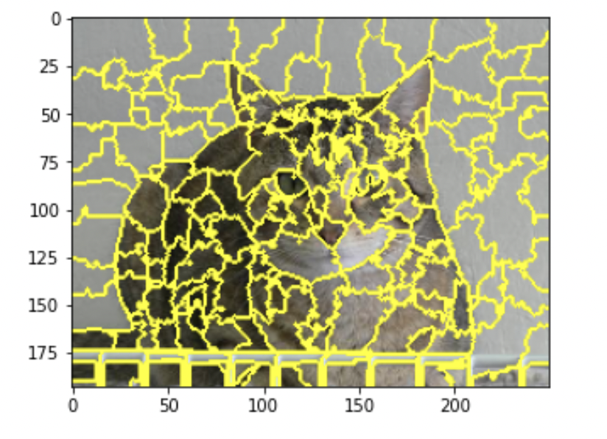
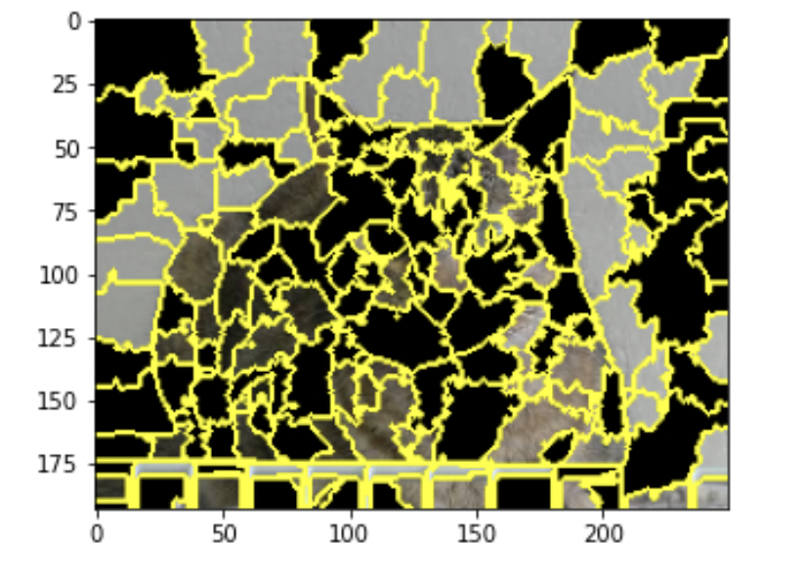
2.5 LIME with Images
Local Explanations
Model Agnostic
Post-hoc Explainability
Fig. 2 We can split the image into superpixels that are randomly turned on and off

Slide 25
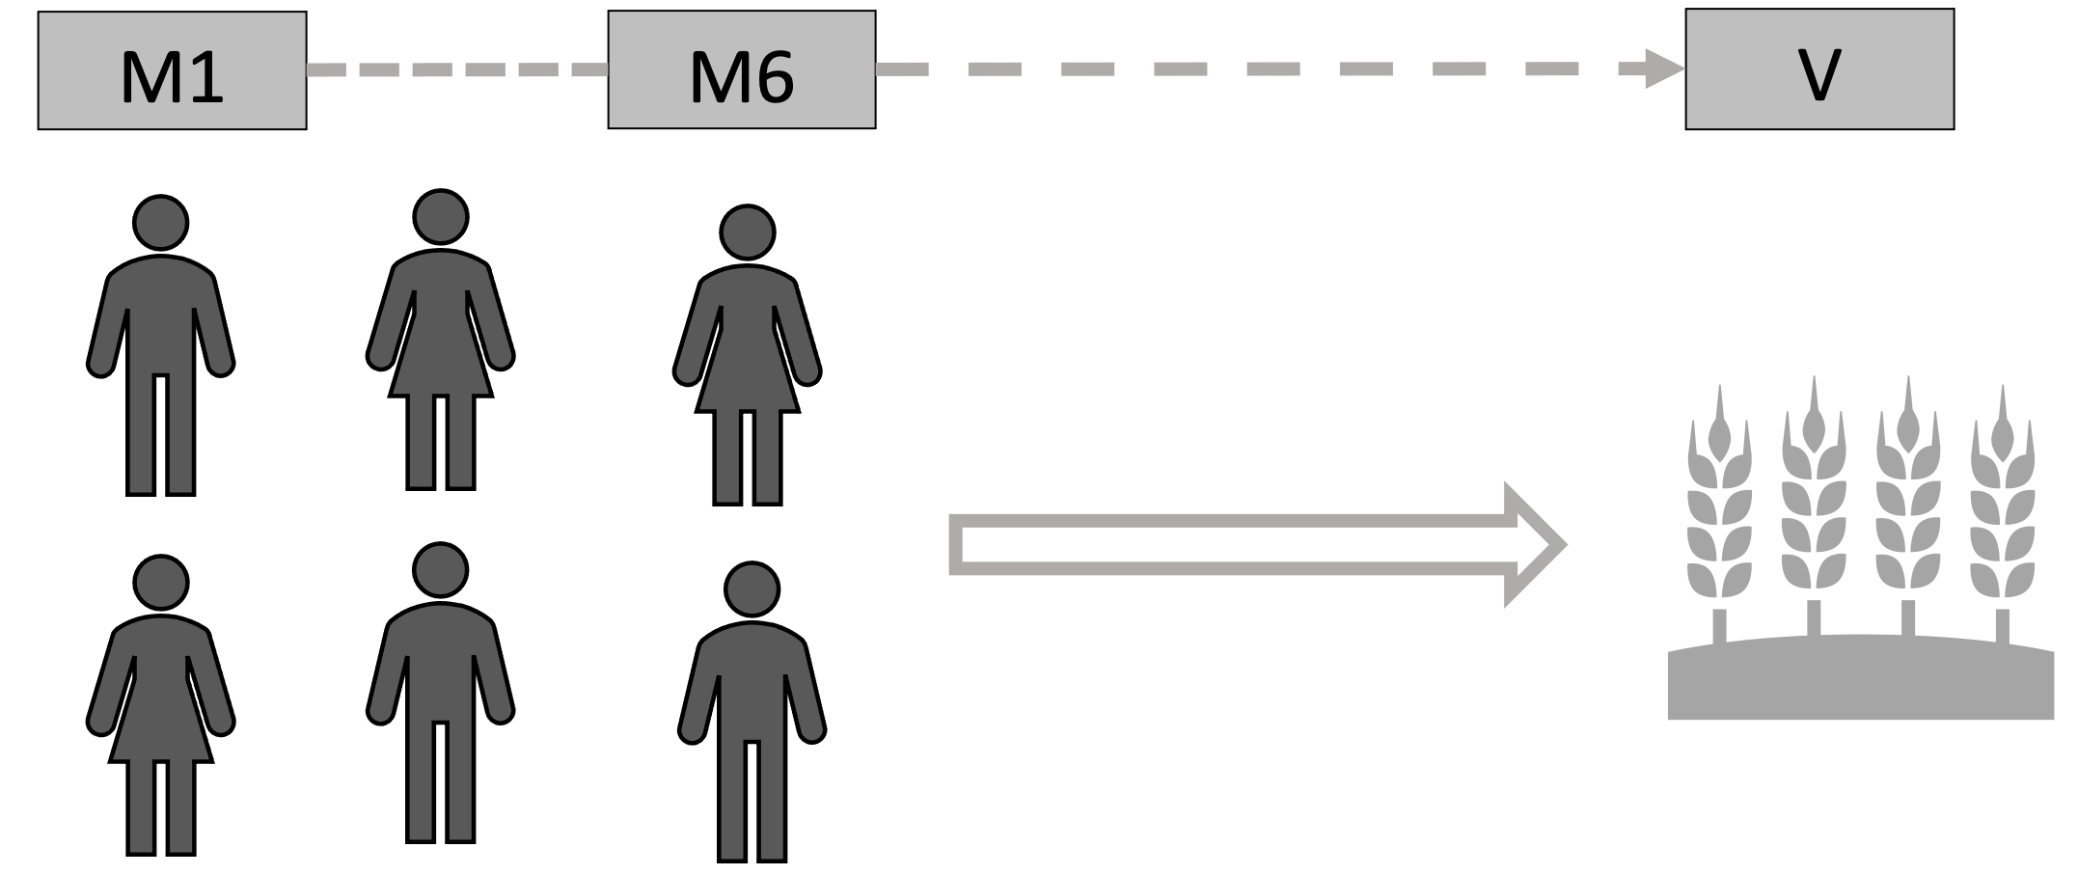
2.6 SHAP
Global/Local Explanation
Model Agnostic
Post-hoc Explainability
If we have a group C working together to deliver output V, how much did each individual contribute to that value?

Slide 26

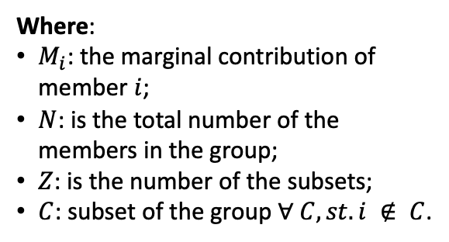
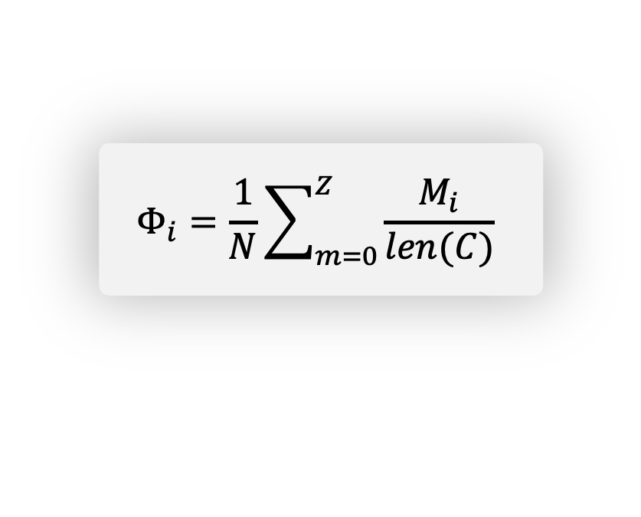
2.6.1 How Shapely values are calculated?
Global/Local Explanation
Model Agnostic
Post-hoc Explainability
Sample (DS)
Predict
Take out feature
Predict again
Compare
Where:
$M_{i}$: the marginal contribution of member $i$;
$N$: is the total number of the members in the group;
$Z$: is the number of the subsets;
$C$: subset of the group $∀ C, st. i ∉ C$.
Mean (all Marginal contributions) = SV
$$Φ_{i}=\frac{1}{N}\sum_{m=0}^{Z}{\frac{M_{i}}{len(C)}}$$
Notes:
**How Shapely values are calculated?
If would like to calculate the shapely value for member 1:
1. Sample a subset $C$ group of several members where member 1 is part of
2. Calculate the value of that this subset produces (let’s call this $V’$)
3. Take out member 1 form the the subset
4. Calculate overall value the coalition produce without member 1
5. Compare it to the original value of overall product (Member 1 value = $V-V’$) (Marginal contribution of member one)
6. Sample a new subset and repeat steps $2 – 5$
7. Do step $6$ for all possible subsets
8. Take the mean of the produced $V’$ values, this will be the Shapley value for member 1. Let’s call it $Φ_i$
9. Same for other members, repeat steps $1 - 8$, we can get $Φ$ values for each member.

Slide 27
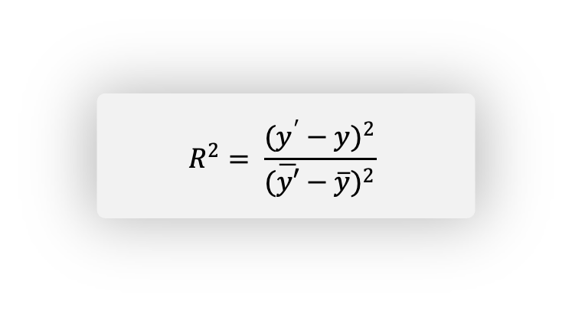
2.7 Global Surrogate
Local Explanations
Model Agnostic
Post-hoc Explainability
Take a subset of the training datasets X’
Get the prediction using the black box model, Y' = f(X')
Train an explainable model on the datasets and their prediction X’, y'
Test thee performance of the new model (surrogate model)
Testing the performance is using R² metric
$$R^{2}= \frac{(y^{′}−y)^{2}}{({\overline{y′}−\overline{y})}^{2}}$$
R² metric

Slide 28
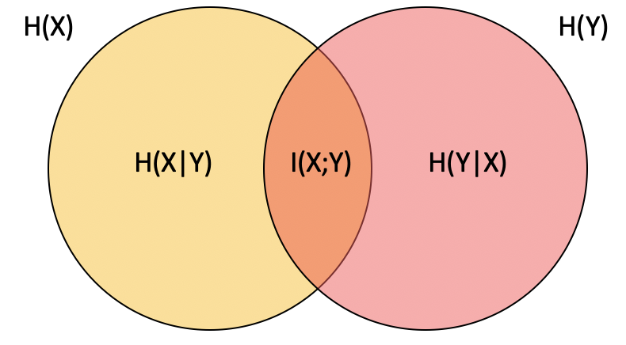
2.8 Information Bottleneck Theory
Global Explanations
Model Specific
Algorithmic
Mutual Information
It is possible to estimate how much information from one layer of a NN is carried to another by using the concept of Mutual Information (MI)
The MI describes the statistical correlation between two random variables (in our case the neurons)
The development of MI during training helps us understand the process of learning during the epochs
Further information can be found on https://arxiv.org/pdf/1602.04938.pdf
Fig. 3 The orange part H(X) describes the
Mutual Information which is the
entropy of X minus the conditional
entropy H(X|Y) of X given Y

Slide 29
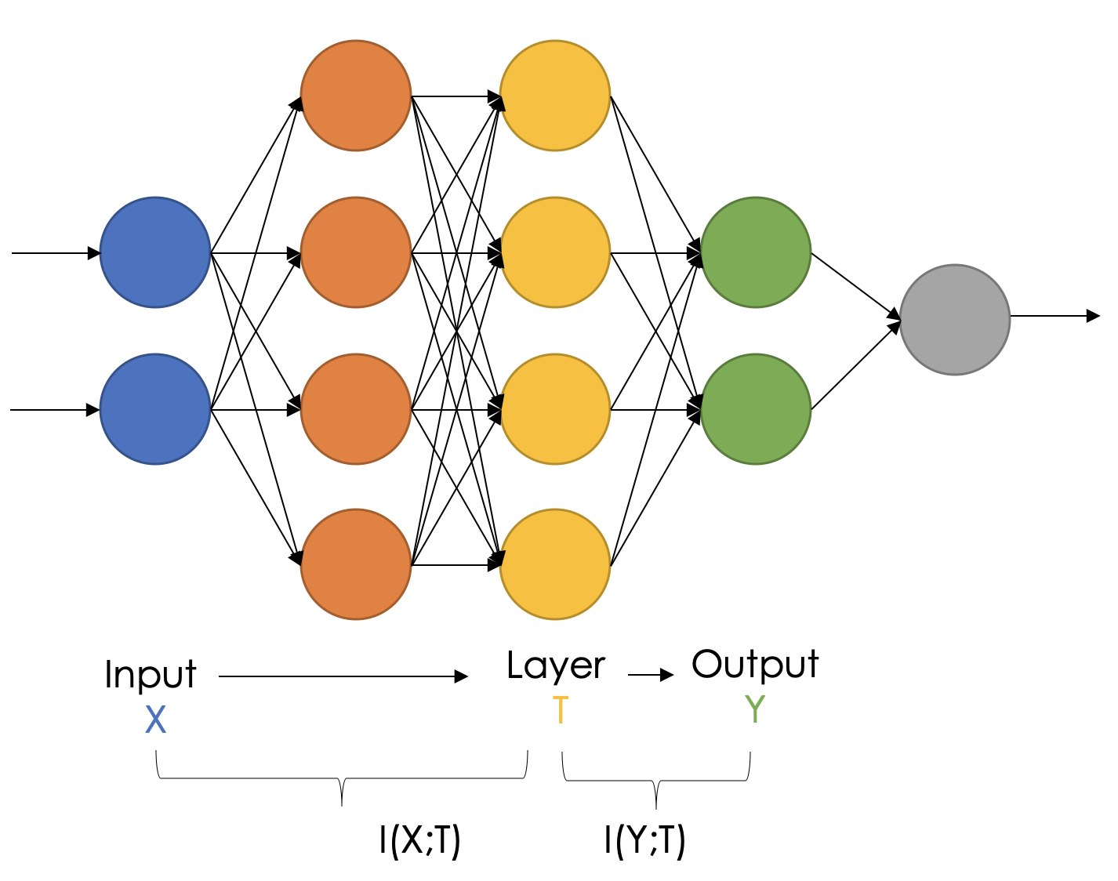
2.8 Information Bottleneck Theory
Global Explanations
Model Specific
Algorithmic
Measuring the MI
I(X;T) is the MI between the input X and a layer T
I(Y;T) is the MI between the layer T and the output y
Estimation Methods
There are several methods to estimate the MI such as
Upper and lower bound
Binning (summarize several neuron‘s output in one bin) [6]
MINE [9]

Slide 30
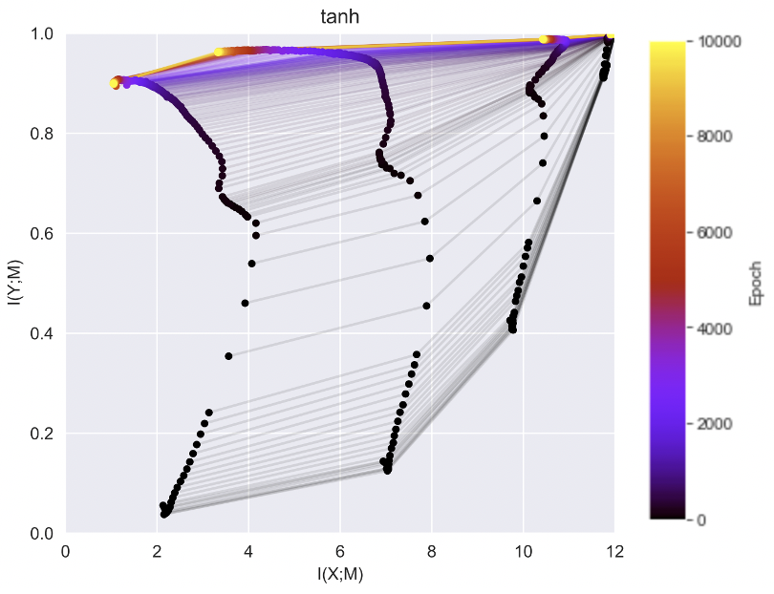
2.8 Information Bottleneck Theory
Global Explanations
Model Specific
Algorithmic
Mutual Information plots
Activation function
The higher the epoch the lighter the color
Every vertical line represents one layer

Slide 31
2.8 Information Bottleneck Theory
Global Explanations
Model Specific
Algorithmic
Phases during training [6]
2. Compression phase
1. Fitting phase

Slide 32
3
Feedback and Outlook

Slide 33
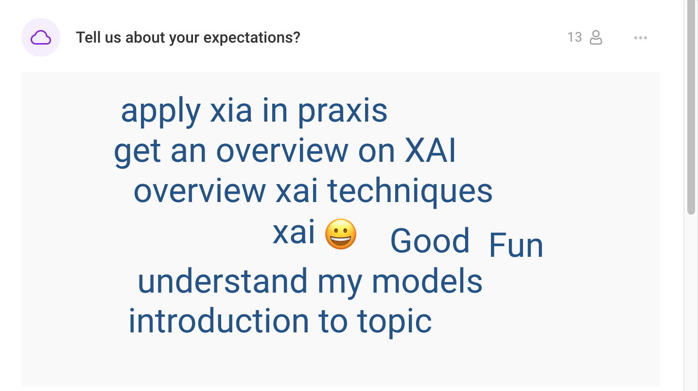

Slide 34
GO TO: Slido.com
# 4109091

Slide 35
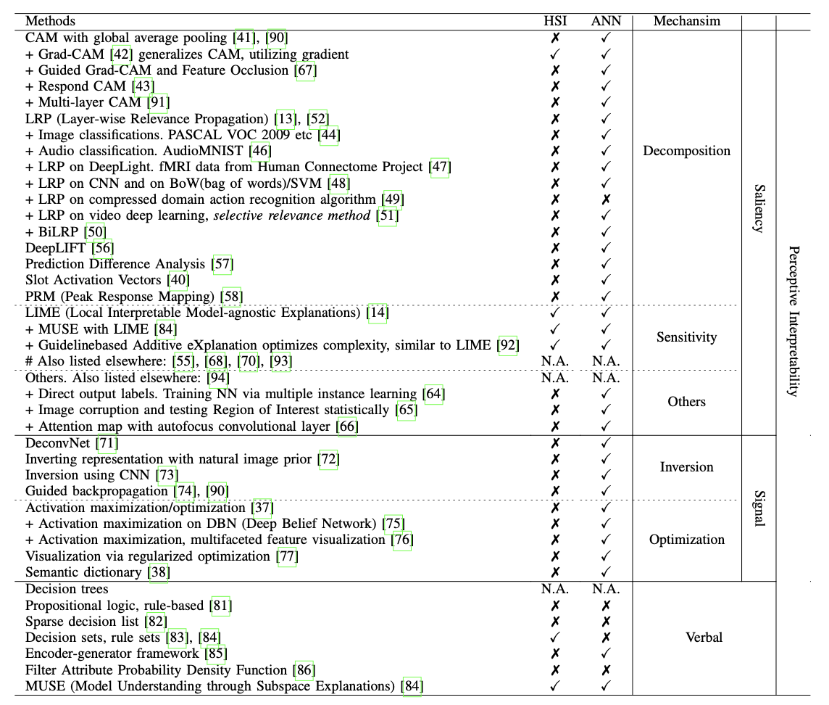
3 Current XAI research
Fig. 4 List of XAI methods [4]

Slide 36




3 Current XAI research
Combine knowledge graphs and neural networks
Knowledge graphs are a tool to represent real world entities (knowledge) in a graph structure
They consist of nodes (entities), their properties and edges (relationships)
It is easy to understand the relationship and influence between several objects
Especially non-insiders can gain a better understanding of the context between entities
Works at
TU Berlin
Speaks at
Studies at
Mahmoud
Speaks at
Lives in
Is in
DL Summit
Takes place in
Sophia
Lives in
Berlin

Slide 37
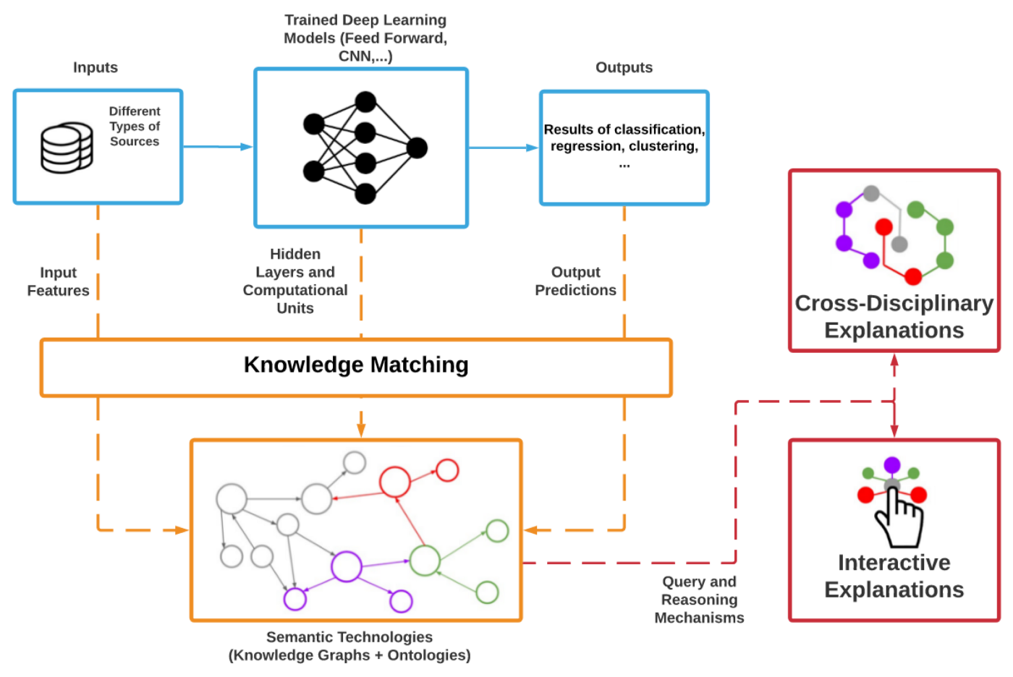
3 Current XAI research
Can be combined with
a SHAP model
Combine knowledge graphs and neural networks [5]
Anomalies between the prediction of the XAI model and the knowledge graph can be further inspected and evaluated from an expert
Using knowledge graphs can be helpful for decision making because related information is provided
Through the integration of a knowledge graph into an AI model, the graph can be queried automatically

Slide 38
3 Current XAI research
Estimation of Mutual Information
Tishby: Information Bottleneck [6]
Two Phases: Fitting phase and compression phase
On the Information Bottleneck Theory of Deep Learning [7]
Results could not be reproduced, relu has no compression phase
Tishby: wrong method for computing MI
Estimating Information Flow in Deep Neural Networks [8]
Goldfeld: The reason for the compression is fixed bin size
Compression is a geometric phenomenon (not information-theoretic)
Mutual Information Neural Estimation [9]
New Method for computing MI
Formal Limitations on the Measurement of Mutual Information [10]
MINE had mistake in their equation

Slide 39
Sources
[1] GUNNING, D.; AHA, D.: DARPA’s explainable artificial intelligence (XAI) program. AI Magazine. 2019, vol. 40, no. 2, pp. 44–58.
[2] https://www.kdnuggets.com/2019/12/interpretability-part-3-lime-shap.html
[3] https://www.tibco.com/de/reference-center/what-is-a-random-forest
[4] Tjoa, E; Guan, C (2020): A Survey on Explainable Artificial Intelligence (XAI): Towards Medical XAI, https://arxiv.org/pdf/1907.07374.pdf
[5] https://towardsdatascience.com/knowledge-graphs-for-explainable-ai-dcd73c5c016
[6] N. Tishby, R. Schwartz-Ziv. (Mar. 2017). Opening the black box of Deep Neural Networks via Information. Available: https://arxiv.org/pdf/1703.00810. pdf
[7] A. M. Saxe, A. Kolchinsky, D. D. Cox. (Feb. 2018). On the Information Bottleneck Theory of Deep Learning. Available: https://openreview.net/forum? id=ry_WPG-A-
[8] Z. Goldfeld, E. van den Berg, K. Greenewald, I. Melnyk, N. Nguyen, B. Kings- bury, Y. Polyanskiy. (Oct. 2018). Estimating Information Flow in Deep Neu- ral Networks. Available: http://people.lids.mit.edu/yp/homepage/data/ dnn-infoflow.pdf
[9] M. I. Belghazi, A. Baratin, S. Rajeswar, S. Ozair, Y. Bengio, A. Courville, R. D. Hjelm. (Jan. 2018). Mutual Information Neural Estimation. Available: https://arxiv.org/pdf/1801.04062.pdf
[10] D. McAllester, K. Stratos. (Nov. 2018). Formal Limitations on the Measurement of Mutual Information. Available: https://arxiv.org/pdf/1811.04251.pdf

